Slide 1
RISC-V Tutorial
Zhiming Zhang

Slide 2
Outline
Verilator simulation
Hello world!
Spectre V1 example
Configure your own BOOM -- SSE-RV example
Cycle-by-cycle debugging
FPGA emulation
Original BOOM SoC
SSE-RV BOOM SoC
General Vivado design chain
Vivado integrated logic analyzer (ILA)
Microarchitectural attack replications on SonicBOOM
Extension of SSE-RV
Fuzzer development for SonicBOOM

Slide 3
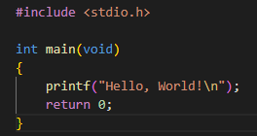

Verilator Simulation
Hello world!
Follow https://chipyard.readthedocs.io/en/latest/Chipyard-Basics/Initial-Repo-Setup.html#initial-repository-setup to setup the Chipyard environment to run Verilator
Compile a SmallBoomConfig on Verilator
Go to chipyard/sims/verilator, then
Create a hello.c
Compile hello.c using the riscv64-unknown-elf-gcc in chipyard/riscv-tools-install/bin
Run Verilator
1)
2)

Slide 4
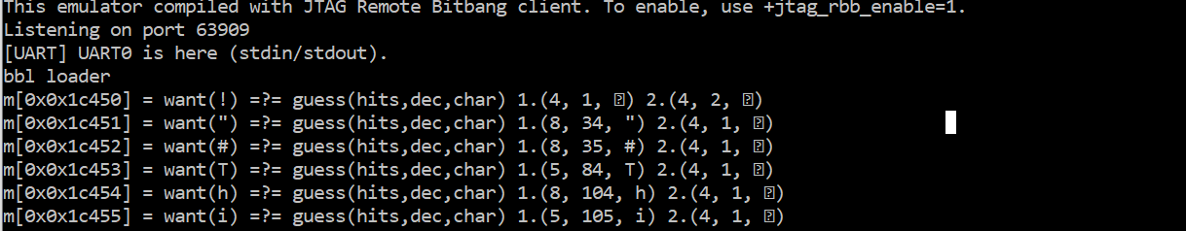
Verilator Simulation
Spectre V1 attack example
Understand the Spectre V1 code in https://github.com/sabbaghm/boom-attacks
Compile Spectre V1
Perform Spectre V1 attack on SonicBOOM
Secret retrieving!

Slide 5
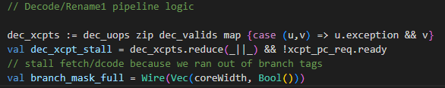
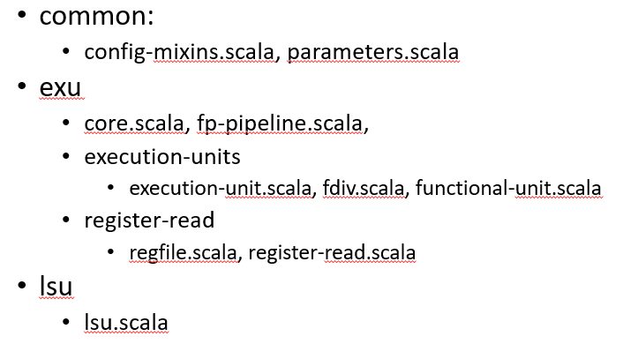
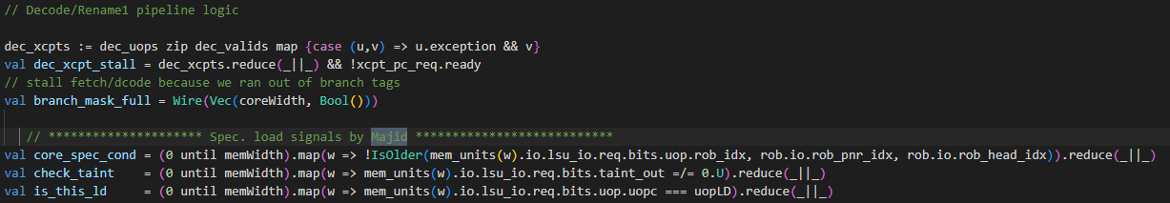
Verilator Simulation
Configure your own BOOM -- SSE-RV example
Find the SSE-RV protected BOOM core in Sequoia server /home/majid/unified_MajidSabbagh_PhD under SSE-RV/SonicBoom
Go to chipyard/generators/boom/src/main/scala
Modify the Chisel source codes based on SSE-RV BOOM core
Involved files
Original:
SSE-RV:

Slide 6
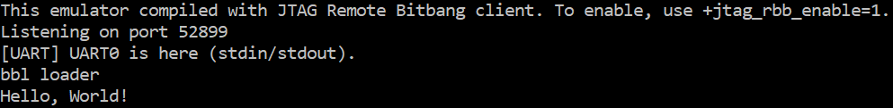
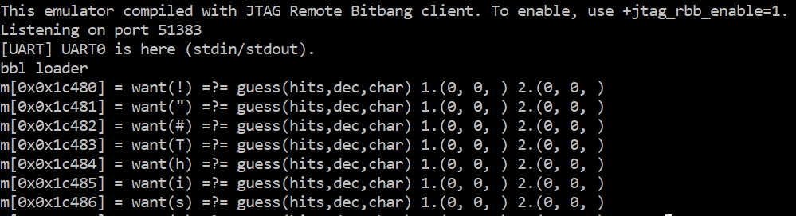
Verilator Simulation
Configure your own BOOM -- SSE-RV example
Source env.sh and compile a SmallBoomConfig
Test SSE-RV, you should see
Hello world runs correctly
Spectre V1 is mitigated
Leaking is prevented!

Slide 7
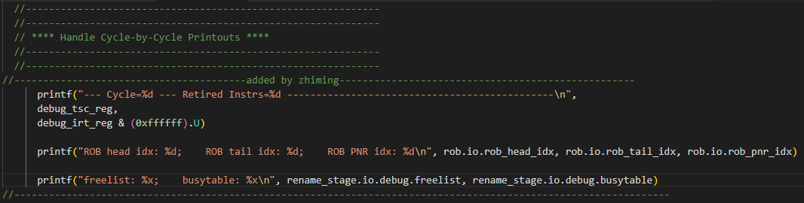
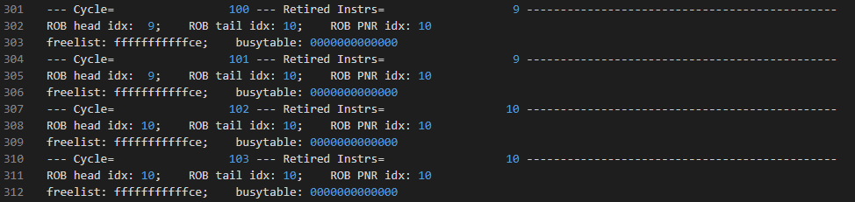
Verilator Simulation
Debug example -- cycle-by-cycle log
In core.scala, add the following printfs to the Handle Cycle-by-Cycle Printouts section
Compile a SmallBoomConfig with debug enabled
Simulate hello world using the newly configured simulator-chipyard-SmallBoomConfig-debug
hello.log:

Slide 8
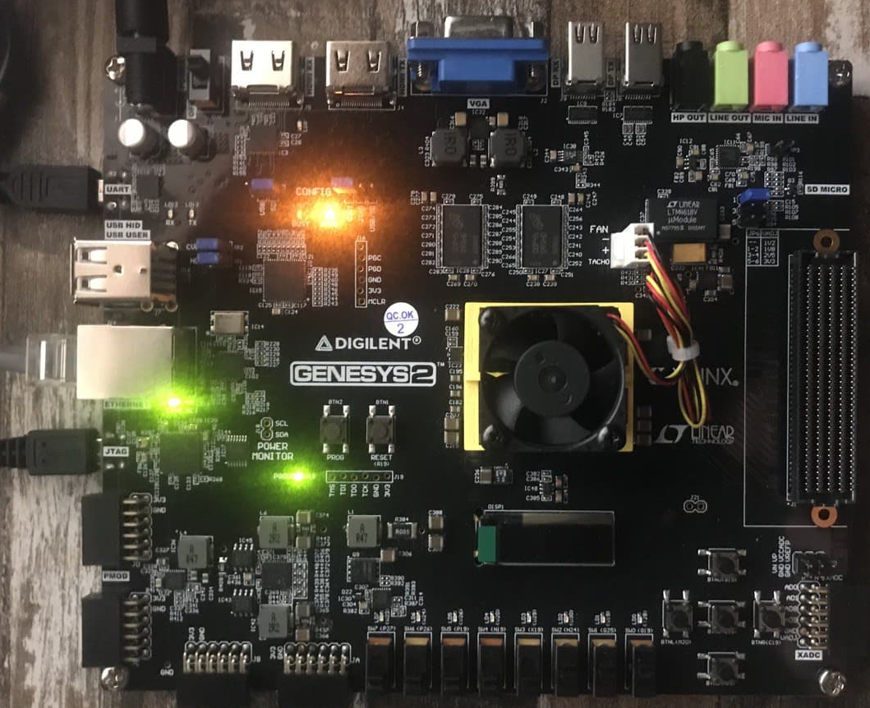
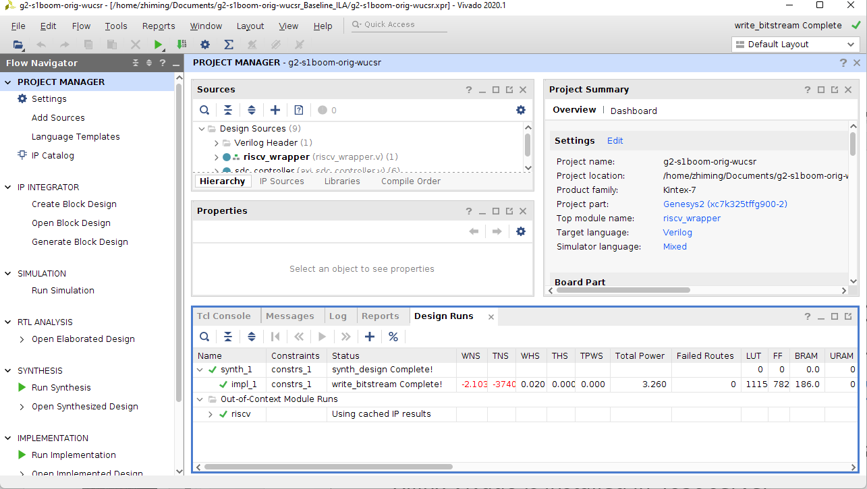
Original BOOM SoC
Find the Xilinx Genesys-2 FPGA board in ISEC room463c
Power up the board and connect both USB and UART ports with a computer
Go to https://github.com/eugene-tarassov/vivado-risc-v and follow the steps to program Genesys-2 with original BOOM-based SoC
You can skip “Prepare the SD card” since there is already a card prepared
Xilinx Vivado is installed in 463c server

Slide 9
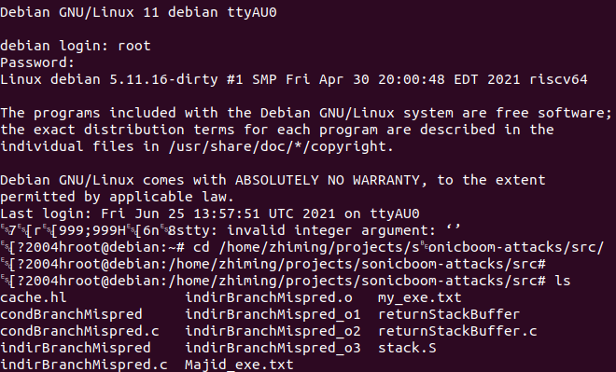
Original BOOM SoC
Login to the Debian system running on the FPGA board
Through UART: sudo miniterm /dev/ttyUSB* 115200
Through SSH: ssh debian@ipFPGA or ssh root@ipFPGA
Username/password: debian/debian or root/root
Uart transmission may bring in weird symbols but that is only a display issue
Hello world!
Create a hello world c code on Debian
Compile it using gcc and run the compiled executable
Run Spectre attacks on FPGA
The FPGA-version of Spectre attacks are slightly different from the Verilator-version and can be found at: https://github.com/sabbaghm/sonicboom-attacks

Slide 10
SSE-RV BOOM SoC
In the newly cloned vivado-risc-v repo, locate the BOOM generator at vivado-risc-v/generators/riscv-boom
Modify the Chisel source codes towards SSE-RV (Same as what we did in Verilator simulation)
Regenerate bitstream
source /opt/Xilinx/Vivado/2020.1/settings64.sh
make CONFIG=rocket64w1 BOARD=genesys2 bitstream
Program FPGA and boot the system (no need to reprepare SD card)
Perform Spectre attacks again to see if leakage is mitigated

Slide 11
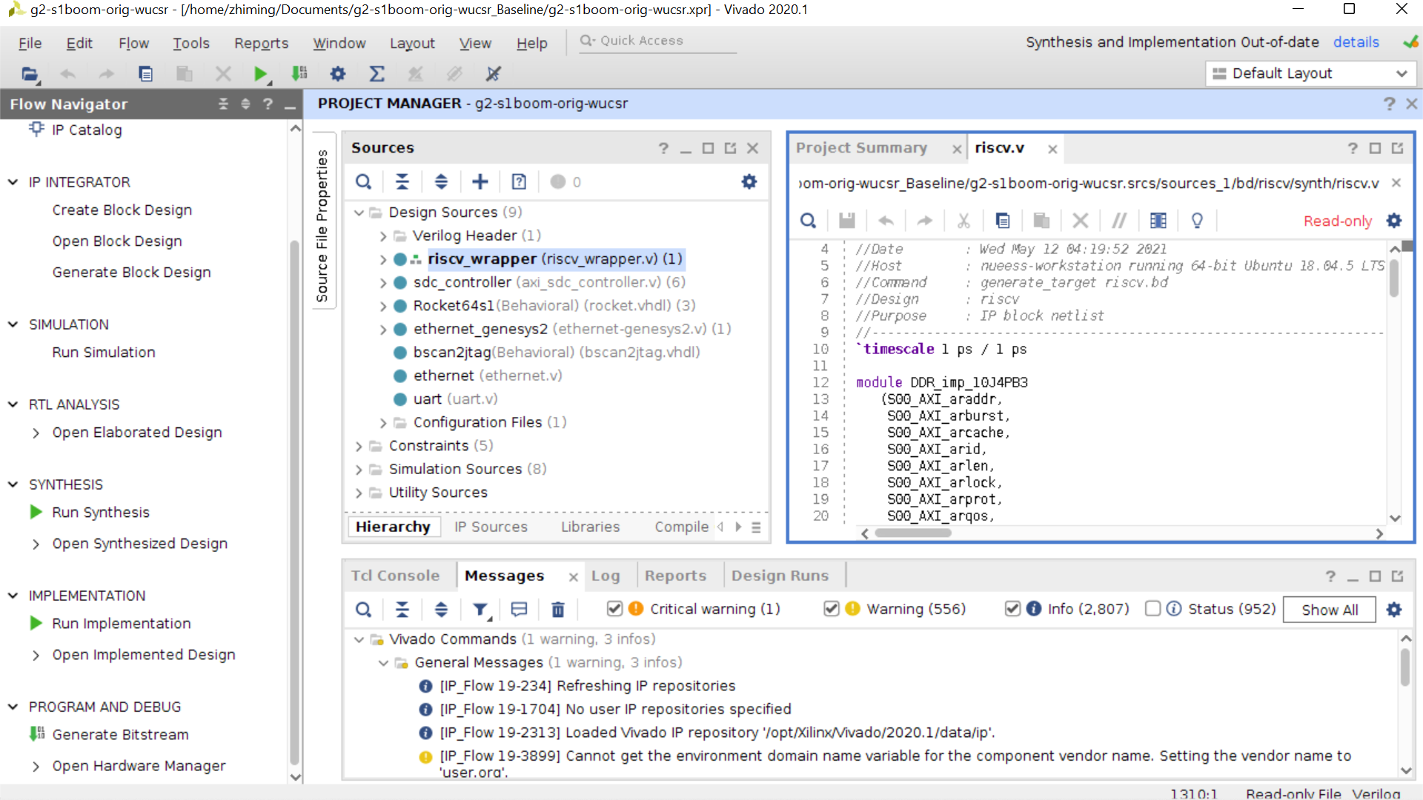
Vivado General Design Chain
Source hierarchy
Source file editing
Main design flow
Check errors, warnings, infos, …

Slide 12
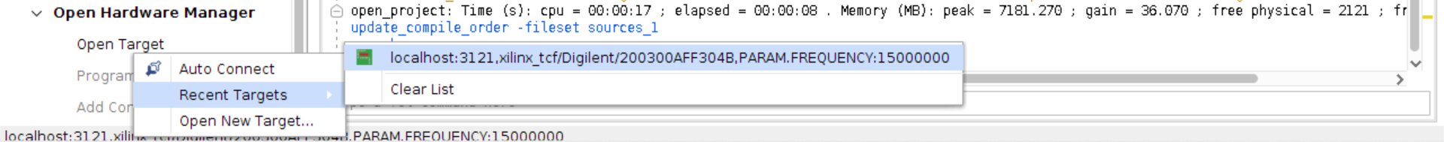
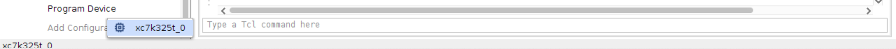
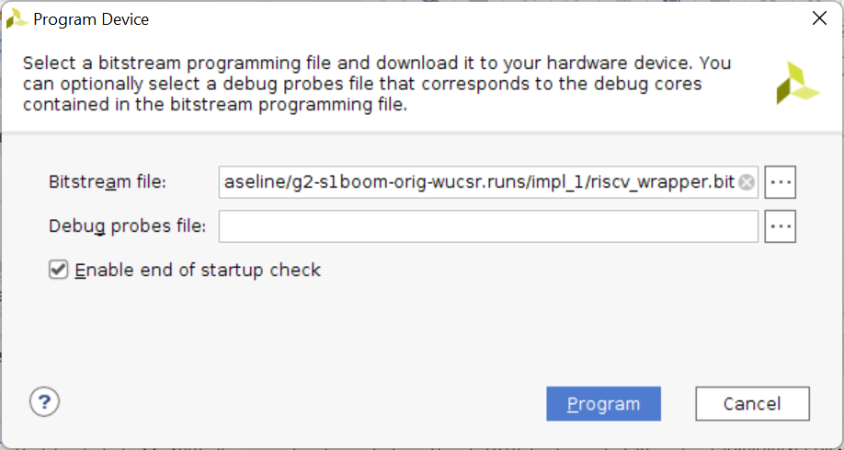
Vivado General Design Chain
To generate bitstream
Run Synthesis → Run Implementation → Generate Bitstream
To program FPGA
Go to Open Hardware Manger → Open Target
Click on Program Device
Make sure the bitstream is correct, then click Program

Slide 13
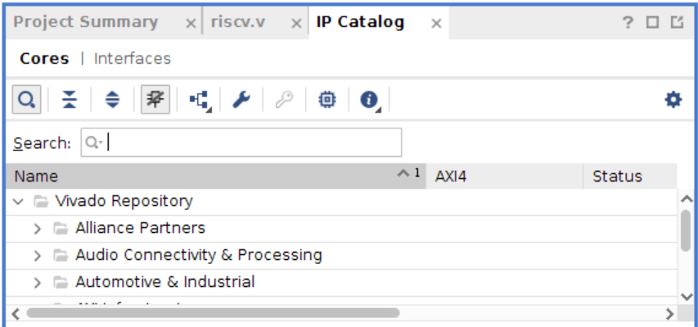

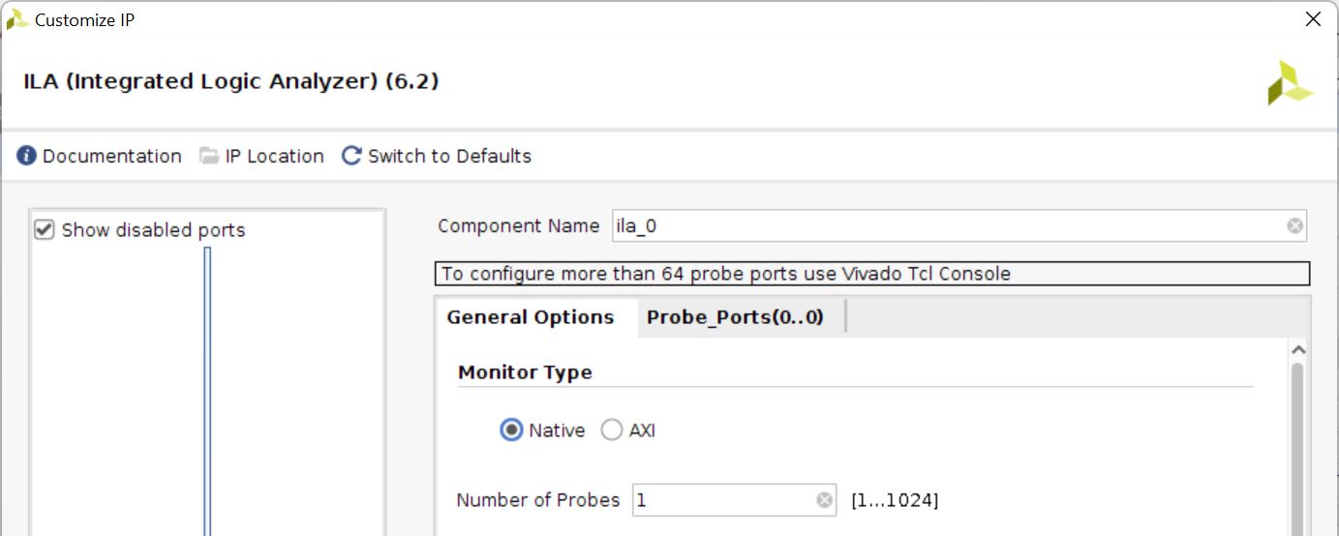
Integrated Logic Analyzer (ILA)
We can use Vivado ILA to help debugging FPGA design
Click on the left-hand side of Vivado GUI
An IP Catalog subwindow is then added to the source editing area
Go to → →
A Customize IP window will show up

Slide 14

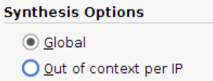

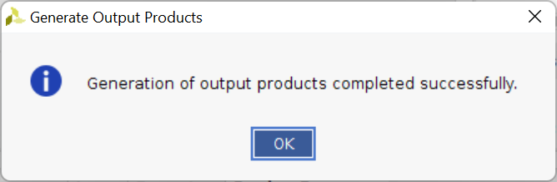
Integrated Logic Analyzer (ILA)
In the Customize IP window
Set up the Number of Probes
Check Advanced Trigger
Set up the width of each probe
Click OK
In the following Generate Output Products window
Choose Synthesis Options as Global
Click Generate, the ILA module is then added to Design Sources

Slide 15
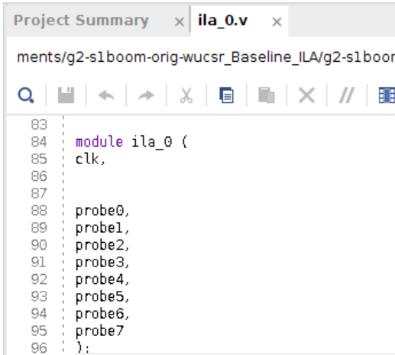
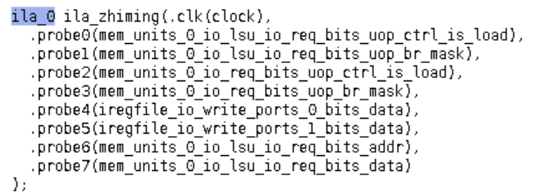
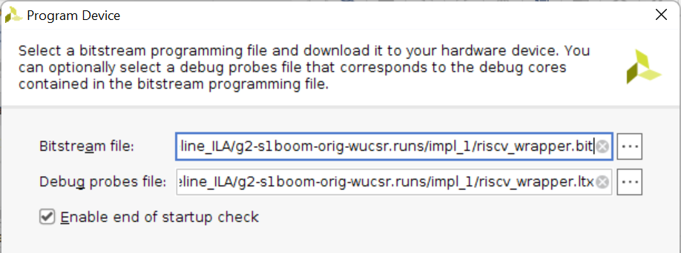
Integrated Logic Analyzer (ILA)
Check the Verilog file of ILA module and instantiate it by conducting the ports
Rerun the design flow to generate a new bitstream
When programming the FPGA, a new Debug probes file is also included

Slide 16
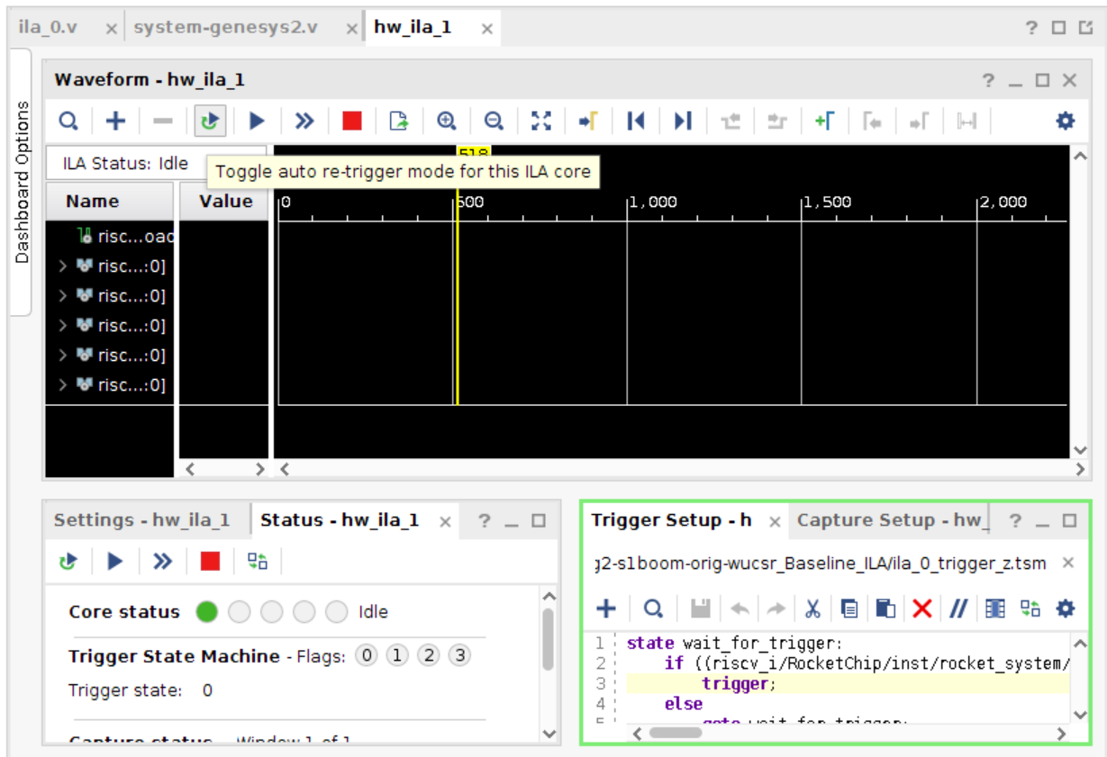
Integrated Logic Analyzer (ILA)
Now HARDWARE MANAGER window looks like this
Create a .tsm file to set up trigger conditions

Slide 17

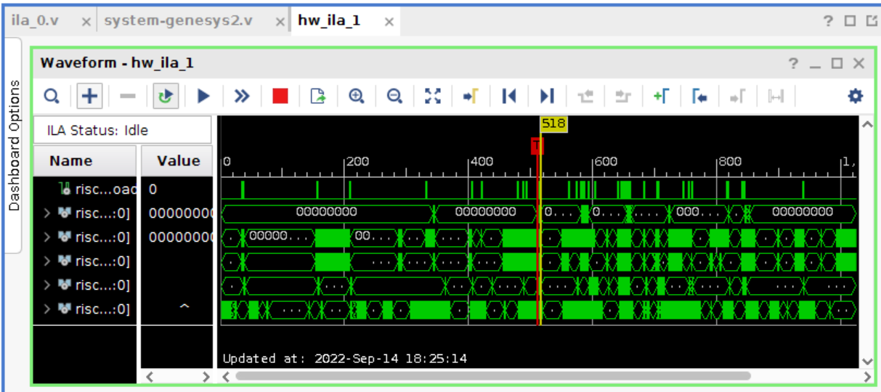
Integrated Logic Analyzer (ILA)
Check the option , then click , the waveform will be updated every time a triggering condition is met
For more details about ILA and programming .tsm trigger file, please check this video: https://youtu.be/_ljXMoGJ5iM

